Slide 1
Chapter 8 Human Health and Diseases
Chickengunia
Pathogens
filariasis
Ascariasis
Dengue
parasites causing human diseases and their Control
Pneumonia
malaria
typhoid
Basic concepts of immunology
Vaccines
cancer
Antibiotics
Drug
Adolescence
HIV
AIDS
Synthetic plant-derived drugs
Alcohol abuse

Slide 2
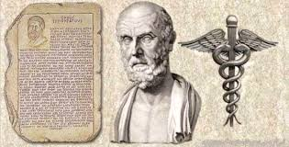
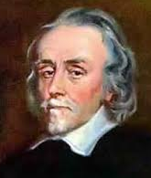
Development of concept of Health
Hippocrates¹ (Greeks) and Indian Ayurveda system of medicine considered: health as a state of body and mind where there is a balance of certain humors.
They thought that persons with ‘black bile’ belonged to hot personality and would have fevers i.e. pure reflective thought.
William Harvey disproved the ‘good humor’ hypothesis of health using experimental method and the demonstrated the normal body temperature in persons with black bile using thermometer.
Later, biology stated that ‘Mind and mental state can affect our health’ i.e. mind influences neural system, endocrine system, immune system and that our immune system maintains our health.
Hippocrates
William Harvey
(Discovered blood circulation )
1. Medical practitioner who is regarded as the father of medicine (circa 460-377 BC)
Notes:
Long time back, Hippocrates (Greeks) and Indian Ayurveda system of medicine considered health as a state of body and mind where there was a balance of certain ‘humors’.
They thought that persons with ‘black bile’ belonged to hot personality and would have fevers. This idea was arrived at by pure reflective thought.
Discovery of blood circulation by William Harvey using experimental method and the demonstration of normal body temperature in persons with black bile using thermometer disproved the ‘good humor’ hypothesis of health.
Later, biology stated that ‘Mind and mental state can affect our health’ i.e. mind influences neural system, endocrine system, immune system and that our immune system maintains our health.

Slide 3
Human Health
Human health is affected by –
genetic disorders – deficiencies with which a child is born and deficiencies/defects which the child inherits from parents from birth;
infections
life style including food and water we take, rest and exercise we give to our bodies, habits that we have or lack etc.
Physical surroundings
Social environment
Economic status

Slide 4
How do you define health?
Health could be defined as a state of complete physical, mental and social well-being.
Significance of health (Why do we consider health is essential in one’s life?)
Healthy people are more efficient at work. This increases productivity and brings economic prosperity.
Health increases longevity of people and reduces infant and maternal mortality.

Slide 5
Disease
Malfunctioning of one or more organs or systems of the body leads to disease, characterised by various signs and symptoms.
Diseases can be broadly grouped into infectious and non-infectious.
Q. Explain infectious diseases.
Infectious/Communicable diseases | Non-infectious/Non-communicable diseases
Diseases which are easily transmitted from an individual to another
Very common i.e. every one of us suffers from these at sometime or other
Example: Common cold
Diseases which are not easily transmitted from one person to another
Not very common and some people suffers from these at sometime or other
Example; cancer (major cause of death)

Slide 6
Maintaining and achieving good health
Enlist important things you need to do for maintaining and achieving good health.
Ways for maintaining and achieving good health;
Balanced diet,
Personal hygiene ,
Regular exercise: Practicing yoga to achieve physical and mental health.
Awareness about diseases and their effect on different bodily functions,
Vaccination and immunisation against infectious diseases,
Proper disposal of wastes,
Control of vectors and
Maintenance of hygienic food and water resources.

Slide 7
Common Diseases In Humans
What are pathogens?
Answer: Pathogens are disease causing organisms belonging to bacteria, viruses, fungi, protozoans, helminths, etc.
All parasites are pathogens as they cause harm to the host by living in (or on) them.
The pathogens can enter our body by various means, multiply and interfere with normal vital activities, resulting in morphological and functional damage.
Pathogens have to adapt to life within the environment of the host. For example, the pathogens that enter the gut must know a way of surviving in the stomach at low pH and resisting the various digestive enzymes.

Slide 8
Common Human diseases caused by Bacteria
Common disease | Causative agent | Symtoms | Mode of transmission | Diagnosis
Typhoid
Salmonella typhi
(Pathogenic bacterium)
Sustained high fever (39° to 40°C), weakness, stomach pain, constipation, headache and loss of appetite
Intestinal perforation and death may occur in severe cases
Salmonella typhi contaminated food and water
enter the small intestine and migrate to other organs through blood.
Typhoid fever could be confirmed by widal test
Mary Mallon nicknamed Typhoid Mary. She was a cook by profession and was a typhoid carrier who continued to spread typhoid for several years through the food she prepared.

Slide 9
Common Human diseases caused by Bacteria (Pneumonia, Dysentery, plague, diphtheria, etc.)
Common disease | Causative agent | Symptoms | Mode of transmission
Pneumonia
Bacteria like Streptococcus pneumoniae and Haemophilus influenzae
Fever, chills, cough and headache.
In severe cases, the lips and finger nails may turn gray to bluish in colour.
Inhaling the droplets/aerosols released by an infected person,
Sharing glasses and utensils with an infected person.
Infection of alveoli (air filled sacs) of the lungs resulting collection of fluid in alveoli, leading to severe problems in respiration.

Slide 10
Common Human diseases caused by Virus
Common disease | Causative agent | Symtoms | Mode of transmission
Common cold
Rhino viruses
Infect the nose and respiratory passage but not the lungs
Nasal congestion and discharge, sore throat, hoarseness, cough, headache, tiredness,
Inhalation of droplets resulting from cough or sneezes of an infected person.
Transmitted through contaminated objects such as pens, books, cups, doorknobs, computer keyboard or mouse, etc.
(One of the most infectious human ailments usually last for 3-7 days)
Chikungunya is vector-borne diseases. Aedes mosquitoes is the vector of Chikungunya.

Slide 11
Diseases caused by helminths
Common Disease | Causative agent | Symtoms | Mode of transmission
Ascariasis
Ascaris
(intestinal parasite)
Internal bleeding, muscular pain, fever, anemia and blockage of the intestinal passage
The eggs of the parasite are excreted along with the faeces of infected persons which contaminate soil, water, plants, etc.
A healthy person acquires this infection through contaminated water, vegetables, fruits, etc.
Helminths like common round worm, Wuchereria and filarial worm are also pathogenic to man

Slide 12
Diseases caused by helminths
Common Disease | Causative agent | Symtoms | Mode of transmission
Elephantiasis or filariasis Wuchereria (the filarial worm) cause a slowly developing chronic inflammation* of the lymphatic vessels of the lower limbs
Wuchereria
(W. bancrofti and W. malayi)
Genital organs are also often affected, resulting in gross deformities
The pathogens are transmitted to a healthy person through the bite by the female mosquito vectors.
*In+flame+ mation = inflammation
Infection (by pathogen), ----→ pain ----→ Accumulation of body fluid ----→ discolouration ----→ Swelling

Slide 13
Diseases caused by fungi
Common Disease | Causative agent | Symtoms | Mode of transmission
Ringworms A common infectious diseases in human.
Fungi belonging to the genera Microsporum, Trichophyton and Epidermophyton
Fungal growth in skin folds (groin or between the toes) is supported by body heat and moisture.
Appearance of dry, scaly lesions on various parts of the body such as skin, nails and Scalp.
These lesions are accompanied by intense itching.
Ringworms are generally acquired from soil or by using towels, clothes, comb, etc of infected individuals.

Slide 14
Diseases caused by protozoans
Common Disease | Causative agent | Symtoms | Mode of transmission
Amoebiasis (Amoebic dysentry)
Entamoeba histolytica
Protozoan parasite in the large intestine of human
Constipation, abdominal pain and cramps, stools with excess mucous and blood clots
Vectors like Houseflies act as mechanical carriers and transmit the Entamoeba histolytica from faeces of infected person to food and food products, thereby contaminating them.
Drinking water and food contaminated by the faecal matter are the main source of infection

Slide 15
Diseases caused by protozoans
Common Disease | Causative agent | Preventive and control measures | Symtoms | Diagnosis test | Treatment
Malaria
Plasmodium
(P. vivax, P. malaria and P. falciparum)
P. falciparum causes malignant malaria and can even be fatal
Controlling female anopheles mosquito (vector) population
Chill and high fever recurring every three to four days.
Some people may experience: Abdomen and muscle pain, fatigue, fever, night sweats and sweating , shivering, Diarrhoea, nausea, or vomiting fast heart rate, headache, mental confusion,
Blood test
Medication

Slide 16
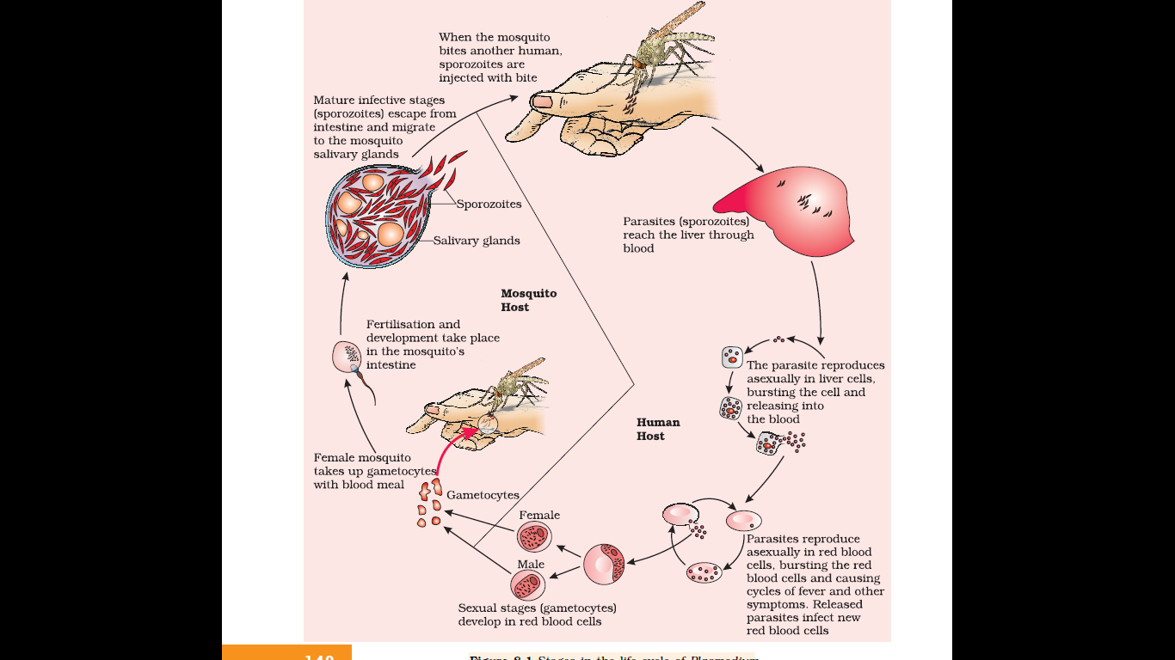
Life cycle of Plasmodium
The malarial parasite requires two hosts viz., human and mosquitoes to complete its life cycle
The female Anopheles mosquito is the vector (transmitting agent) i.e. transmit plasmodium which causes malaria.

Slide 17
Life cycle of Plasmodium
Malaria patient (Plasmodium infected person)
Female Anopheles mosquito bites an infected person
Plasmodium enter the mosquito’s body and undergo further development
The parasites multiply within the mosquito to form sporozoites that are stored in their salivary glands.
When these Anopheles mosquito bite a healthy human, the sporozoites (infectious form) are introduced into his/ her body.
Plasmodium multiply within the liver cells
Attack the Red Blood Cells (RBCs) resulting in their rupture
The rupture of RBCs is associated with release of a toxic substance, haemozoin, which is responsible for the chill and high fever recurring every three to four days.

Slide 18
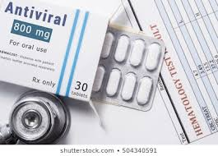
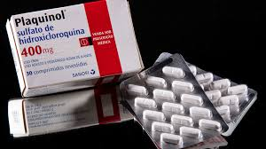
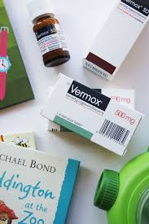

Principles of treatment of diseases
Diseases can be treated by following later mentioned treatment principles;
1. Medication for reducing symptoms or effects of diseases and killing causative agents. Medicines may be as follows;
Antibiotics for stopping inflammation by killing infectious agents like bacteria and fungi.
Antiviral medicines for killing viruses
Anti-protozoal drugs kill protozoans
Medicine to kill worms
2. Bed rest to conserve energy

Slide 19
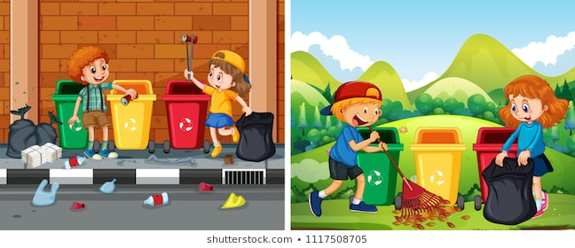
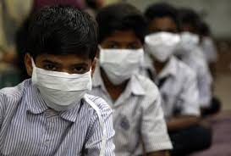
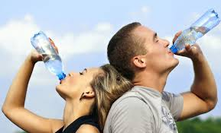
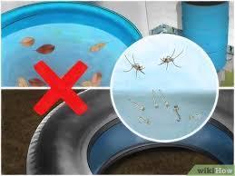
Principles of prevention of diseases
Prevention of disease is more desirable than treatment of it.
‘Prevention of disease is better than cure’.
Diseases can be prevented by following the given preventive measures;
Following proper personal hygiene (bathing, washing your hands, brushing your teeth, consumption of clean drinking water, food, vegetables, fruits, etc)
Following proper public health hygiene (preventing disease, sanitation, control of infectious diseases, and improving health services, etc).
Mass immunisation
Mass vaccination.
General preventive practices are;
Airborne can be prevented by avoiding overcrowding/social distancing, wearing masks, etc.
Water borne can be prevented by consuming potable/drinking water.
Vector(like mosquito) borne diseases can be prevented by stopping mosquito breeding.

Slide 20
Prevention and control of many infectious diseases (Like typhoid, amoebiasis and ascariasis)
Measures for personal hygiene include
keeping the body clean;
consumption of clean drinking water, food, vegetables, fruits, etc.
Public hygiene includes
proper disposal of waste and excreta;
periodic cleaning and disinfection of water reservoirs, pools, cesspools and tanks and
observing standard practices of hygiene in public catering.

Slide 21
Prevention and control of many infectious air-borne diseases (pneumonia and common cold)
Following personal hygiene measures
Following public hygiene measures
Avoiding close contact with the infected persons or their belongings.

Slide 22
Prevention and control of many vector borne diseases (like malaria and filariasis)
Measures to control or eliminate the vectors to prevent diseases (like malaria and filariasis)
avoiding stagnation of water in and around residential areas,
regular cleaning of household coolers,
use of mosquito nets,
introducing fishes like Gambusia in ponds that feed on mosquito larvae,
spraying of insecticides in ditches, drainage areas and swamps, etc.
doors and windows should be provided with wire mesh to prevent the entry of mosquitoes.

Slide 23
Pre-test
Why exposures to few of infectious agents result in diseases and not by all the infectious agents?
Answer: Because our body is able to defend itself from most of these foreign agents (with the help of our immune system) i.e immunity.

Slide 24
IMMUNITY

Slide 25
IMMUNITY
Define immunity.
Answer: Immunity is the overall ability of immune system of the host to fight the pathogen.
Two types of Immunity
Innate immunity
Acquired immunity

Slide 26
Innate Immunity
Innate immunity is non-specific type of defence.
Innate immunity is present at the time of birth.
It is accomplished by providing different types of barriers to the entry of the foreign agents into our body.
Innate immunity consist of four types of barriers.
Four types of barriers of innate immunity
Physical barriers
Physiological barriers
Cellular barriers
Cytokine barriers

Slide 27
Four types of barriers of innate immunity
Physical barriers:
Preventing entry of the micro-organisms.
Skin is the main barrier.
Mucus coating of the epithelium lining of respiratory, gastrointestinal and urogenital tracts also help in trapping microbes entering our body.
Physiological barriers:
Acid in the stomach, saliva in the mouth, tears from eyes–all prevent microbial growth.
Cellular barriers:
Certain types of leukocytes (WBC) of our body like polymorpho-nuclear leukocytes (PMNL-neutrophils) and monocytes and natural killer cells (type of lymphocytes) in the blood as well as macrophages in tissues can phagocytose and destroy microbes.
Cytokine barriers:
Virus-infected cells secrete interferons (antiviral proteins) which protect non-infected cells from further viral infection.

Slide 28
Acquired Immunity
Acquired immunity is developed during lifetime of an individual.
Acquired immunity is pathogen specific.
It is characterised by memory i.e. our body when it encounters a pathogen for the first time produces primary response which is of slow and low intensity. Subsequent encounter with the same pathogen elicits a highly intensified secondary or anamnestic response. This is ascribed to the fact that our body appears to have memory of the first encounter.
B-lymphocytes and T-lymphocytes carry out primary and secondary immune responses.

Slide 29
Acquired Immunity
Antibodies/Immunoglobulin are the army of Y-shaped proteins produced into our blood by B-lymphocytes in response to pathogens i.e. to fight with antigens (foreign particles like pathogen –virus, mycoplasma, bacteria, fungi, protozoan, etc).
The T-cells help B cells produce/secrete antibodies.
Production of different types of antibodies/Immunoglobulin like IgA, IgM, IgE, IgD, IgG* etc. in to blood of our body is called as humoral immune response or antibody mediated response.
* Types of antibodies can be remembered as: AGED Mother

Slide 30
Types of acquired Immunity
Humoral immune response/ Antibody mediated immunity
Cell-mediated Immune Response or Cell-mediated immunity (CMI)
The T-lymphocytes mediate CMI.

Slide 31
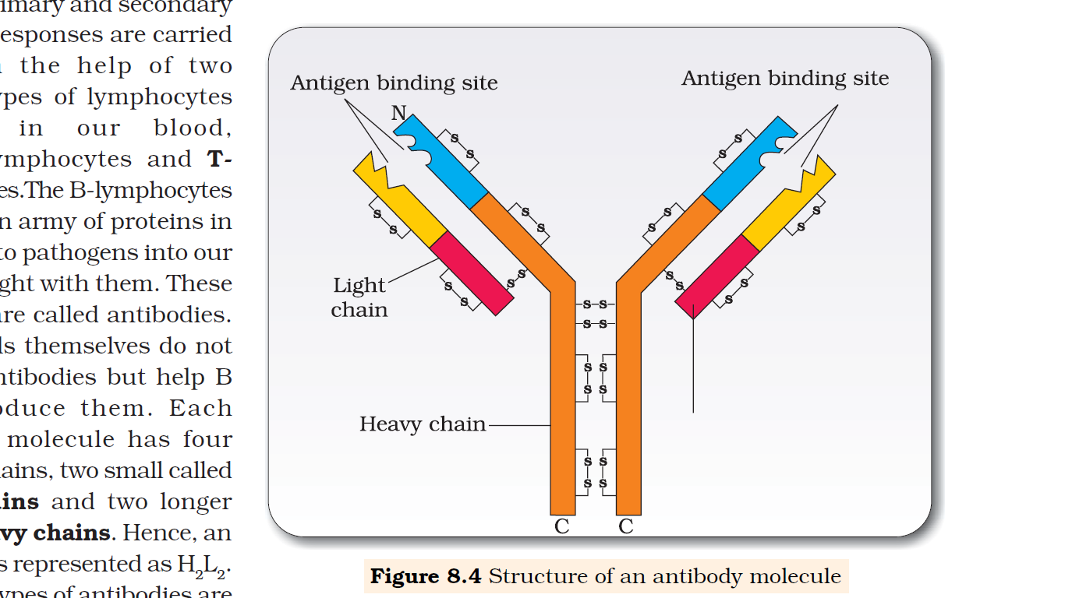
General structure of typical antibody/immunoglobulin
Antibody is structurally represented as H2L2
Each antibody molecule has four peptide chains,
two small chains (light chains) and
two longer chains (heavy chains).
Disulfide bonds

Slide 32
Organ transplantation based questions and answers
Our body is able to differentiate ‘self ’ and ‘non self’ during organ transplantation(True/False)
Can doctors transplant/graft organs like heart, eye, liver or kidney?
Answer: Yes, doctors transplant human organs like heart, eye, liver, kidney donated by suitable donor to enable patient to live a normal life.
Why is it that the organs cannot be taken from just anybody?
OR
Why grafts from just any source -an animal, another primate, or any human beings cannot be made?
Answer: Because the grafts would be rejected sooner or later due to tissue mismatching and blood group mismatching.
What is it that the doctors check before organ transplantation?
Answer: Doctors check tissue matching, blood group matching are essential before undertaking any graft/transplant
Name the medication that has to take by an patient who received organ transplant.
Answer: Immuno suppresants.
Which aquired immunity is responsible for the graft rejection?
Answer: Cell-mediated immune response

Slide 33
Why mother’s milk is considered very essential for the newborn infant?
Answer:
The yellowish fluid colostrum secreted by mother’s mammary gland during the initial days of lactation has abundant antibodies (Ig A) to protect the infant. Such immunity is known as passive immunity.

Slide 34
Active and Passive Immunity
Active Immunity | Passive Immunity
Developed due to exposure of the host to antigens like living or dead microbes or proteins and antibodies (produced in the host body.)
Slow and takes time to give its full effective response.
Induced by injecting the microbes deliberately during vaccination or infectious organisms gaining access into body during natural infection
Developed when ready-made antibodies and antitoxin are directly given to protect the body against foreign agents.
Much faster immune response compared to active immunity.
Example:
Colostrum secreted by mother during the initial days of lactation has abundant antibodies (Ig A) to protect the infant.
The foetus also receives some antibodies from their mother, through the placenta during pregnancy.

Slide 35
Immunisation and vaccination

Slide 36
Principle of immunisation and vaccination
The principle of immunisation or vaccination is based on the property of ‘memory’ of the immune system.

Slide 37
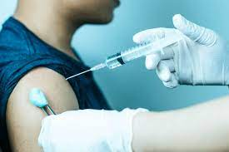
What is vaccination?
Vaccination is introduction of vaccine into our body.
Vaccines are prepared antigenic proteins of pathogen or inactivated/weakened pathogen
Vaccine stimulates massive production of antibodies.
The vaccines generate memory –B and T-cells that recognise the pathogen quickly on subsequent exposure.
The antibodies produced in the body against antigens would neutralise the pathogenic agents during actual infection.

Slide 38
What is Recombinant DNA Vaccine?
Recombinant DNA (rDNA) Vaccines are antigenic polypeptides of pathogen
rDNA vaccines are produced by genetic engineering/ recombinant DNA technology.
rDNA technology vaccines are produced at large scale using bacteria or yeast.
E.g., Hepatitis B vaccine produced from yeast.

Slide 39
What is immunisation?
Immunisation is administration of preformed antibodies or antitoxins into our body for quick immune response to defense against invaders.
Examples:
Direct injection of preformed antibodies, or antitoxin to protect against tetanus.
Introduction of preformed antibodies against the snake venom་ in cases of snakebites.
Direct injection of preformed antibodies or antitoxin is called passive immunisation.

Slide 40
Allergies
Allergy is the exaggerated response of the immune system to certain antigens present in the environment.
Allergens are the substances which induce allergy. For example; mites in dust, pollens, animal dander, etc.
The antibodies produced to allergens are of Ig E type.
Symptoms of allergic reactions
sneezing,
Wheezing,
watery eyes,
running nose and
difficulty in breathing.

Slide 41
Allergies
Allergy is due to the release of chemicals like histamine and serotonin from the mast cells*.
For determining the cause of allergy, the patient is exposed to or injected with very small doses of possible allergens, and the reactions studied.
Drugs like anti-histamine, adrenalin and steroids quickly reduce the symptoms of allergy.
Modern-day life style has resulted in lowering of immunity and more sensitivity to allergens
Many children in metro cities of India suffer from allergies and asthma due to sensitivity to the environment. This could be because of the protected environment provided early in life.
*Mast cell/mastocyte/labrocyte is a type of granulocyte white blood cell derived from the myeloid stem cell that is a part of the immune and neuroimmune systems and contains many granules rich in histamine and heparin.

Slide 42
Auto Immunity
Auto immunity is memory based acquired immunity evolved in higher vertebrates, based on the ability to differentiate foreign organisms (e.g., pathogens) from self cells or due to genetic reasons.
While we still do not understand the basis of this, two corollaries of this ability have to be understood.
higher vertebrates can distinguish foreign molecules as well as foreign organisms.
sometimes, due to genetic and other unknown reasons, the body attacks self-cells.
Question: What is auto-immune disease?
Answer: The damage to the body resulted due to attack by self cells and is called auto-immune disease. For example; Rheumatoid arthritis

Slide 43
Immune System in the Body
The human immune system consists of lymphoid organs, tissues, cells and soluble molecules like antibodies.
Importance of immune system;
it recognizes and responds to antigen (foreign particles) and remembers them.
plays an important role in allergic reactions, auto-immune diseases and organ transplantation.

Slide 44
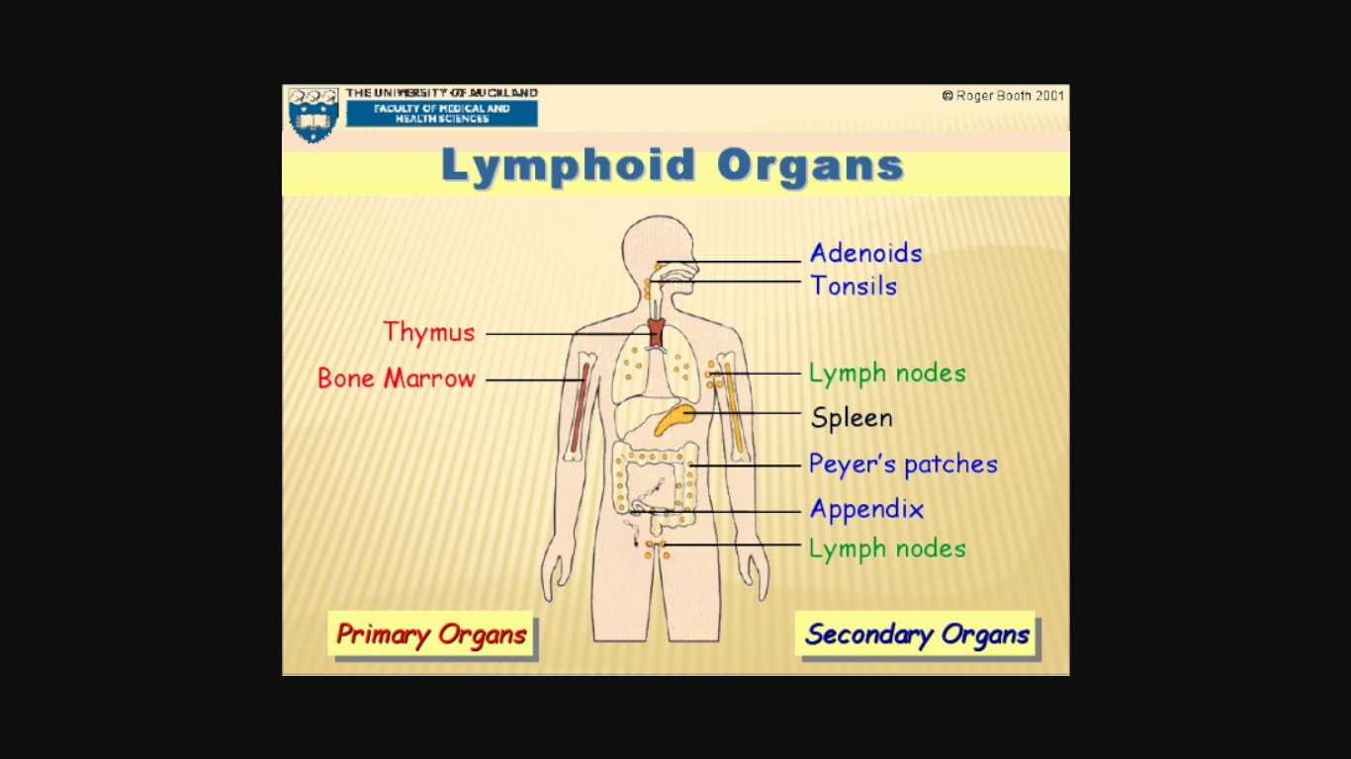

Slide 45
Lymphoid organs
Lymphoid organs are the organs where origin or maturation and proliferation of lymphocytes occur.
The primary lymphoid organs are;
bone marrow and
thymus
Bone marrow and thymus are the organs where immature lymphocytes differentiate into antigen-sensitive lymphocytes.
After maturation, the lymphocytes migrate to secondary lymphoid organs.

Slide 46
Lymphoid organs
Bone Marrow
Bone marrow is the main lymphoid organ where all blood cells including lymphocytes are produced.
Thymus
The thymus is a lobed organ located near the heart and beneath the breastbone/sternum.
The thymus is quite large at the time of birth but keeps reducing in size with age and by the time puberty is attained it reduces to a very small size.
Both bone-marrow and thymus provide micro-environments for the development and maturation of T-lymphocytes.

Slide 47
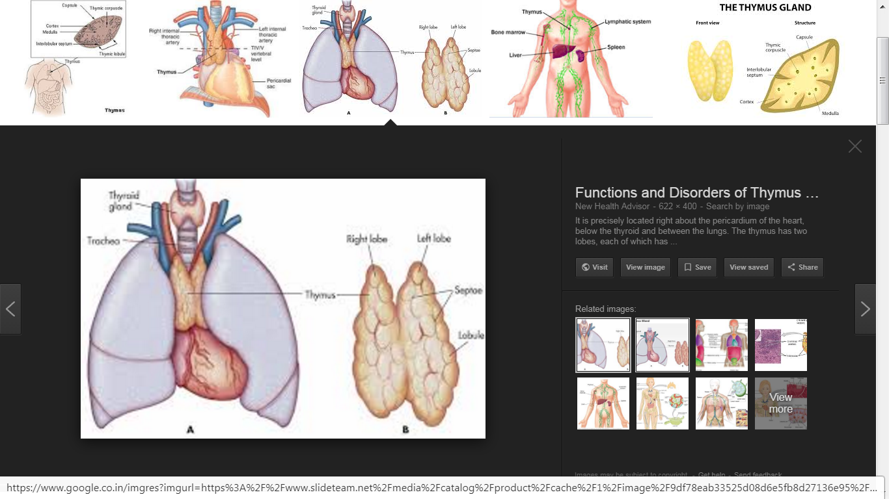
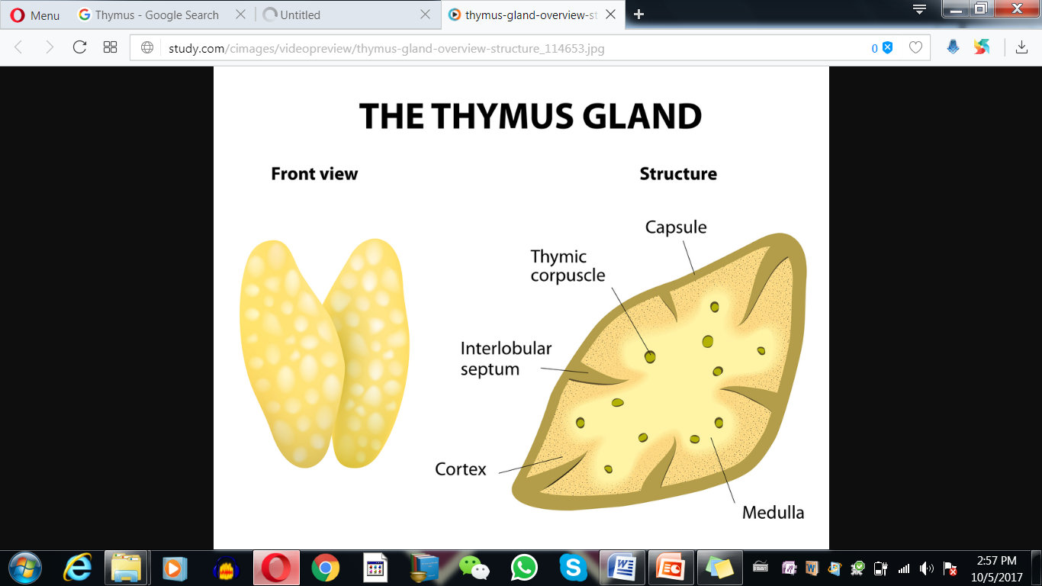

Slide 48
Secondary lymphoid organs
Secondary lymphoid organs are;
spleen,
lymph nodes,
tonsils,
Peyer’s patches of small intestine and
appendix.
The secondary lymphoid organs provide the sites for interaction of lymphocytes with the antigen, which then proliferate to become effector cells.
*Peyer's patches/aggregated lymphoid nodules (Swiss anatomist Johann Conrad Peyer) are small masses of lymphatic tissue found throughout the ileum region of the small intestine. They form an important part of the immune system by monitoring intestinal bacteria populations and preventing the growth of pathogenic bacteria in the intestines.

Slide 49
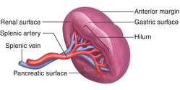
Spleen
The spleen is a large bean shaped organ.
Spleen contains lymphocytes and phagocytes.
It acts as a filter of the blood by trapping blood-borne microorganisms.
Spleen also has a large reservoir of erythrocytes.

Slide 50
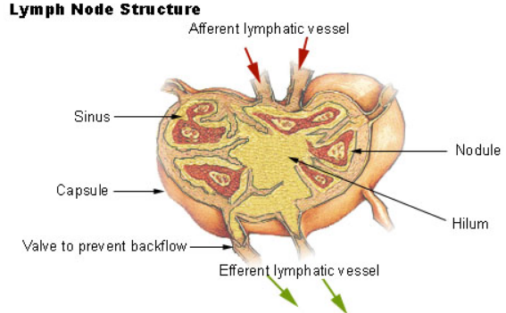
Lymph node
The lymph nodes are small solid structures located at different points along the lymphatic system.
Lymph nodes trap the micro-organisms or other antigens, which happen to get into the lymph or tissue fluid.
Antigens trapped in the lymph nodes are responsible for the activation of lymphocytes present there and cause the immune response.

Slide 51
Lymphoid tissue
50 per cent of the lymphoid tissue in human body are Mucosal associated lymphoid tissue (MALT).
MALT is the Lymphoid tissue that is located within the lining of the major tracts (respiratory, digestive and urogenital tracts).

Slide 52
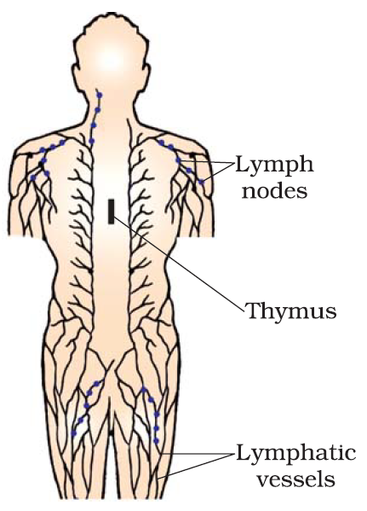
Diagrammatic representation of Lymph nodes/glands

Slide 53
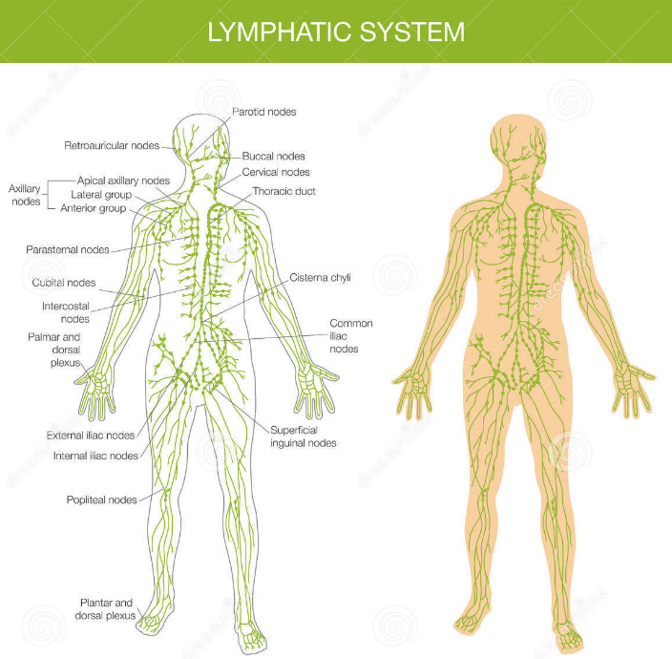

Slide 54
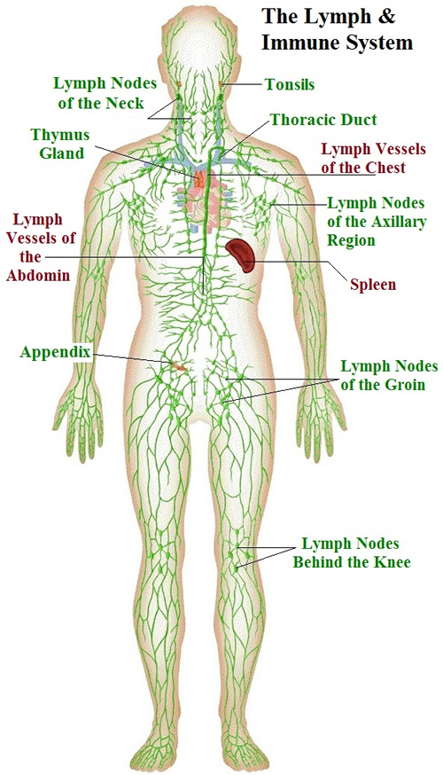

Slide 55
AIDS
(Acquired Immuno Deficiency Syndrome)
AIDS means deficiency of immune system, acquired during the lifetime of an individual indicating that it is not a congenital disease.
‘Syndrome’ means a group of symptoms.
AIDS was first reported in 1981
AIDS has spread all over the world and killed >25 million people.
AIDS is caused by a retrovirus called Human Immuno deficiency Virus (HIV), which have an envelope enclosing the RNA genome.

Slide 56
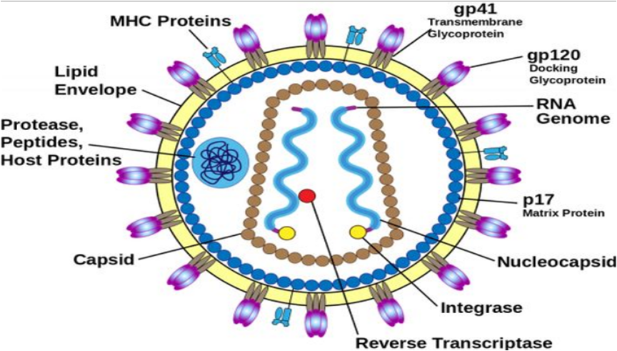
Structure of Human Immunodeficiency Virus (HIV)

Slide 57
Transmission of HIV-infection
Transmission of HIV-infection generally occurs by
sexual contact with infected person,
by transfusion of contaminated blood and blood products,
by sharing infected needles as in the case of intravenous drug abusers and
from infected mother to her child through placenta.

Slide 58
High risk people (HIV)
People who are at high risk of getting HIV infection includes –
individuals who have multiple sexual partners,
drug addicts who take drugs intravenously,
Individuals who require repeated blood transfusions and
children born to an HIV infected mother.

Slide 59
Time-lag
Time-lag is the period between the infection and appearance of AIDS symptoms.
Time lag may vary from a few months to many years (usually 5-10 years).

Slide 60
Prevention of AIDS
As AIDS has no cure, prevention is the best option.
Following conscious behaviour patterns (More often, HIV infection spreads due to conscious behaviour patterns -not something that happens inadvertently, like pneumonia or typhoid).
Proper screening and monitoring of blood for transfution (Infection in blood transfusion patients, new-borns (from mother) etc., may take place due to poor monitoring. The only excuse may be ignorance and it has been rightly said – “don’t die of ignorance”).
Educating people At national level [In India, the National AIDS Control Organisation (NACO) and other non-governmental organisation (NGOs) are doing a lot to educate people about AIDS] and for world wide, WHO has started a number of programmes to prevent the spreading of HIV infection.

Slide 61
Physical and psychological well-being of HIV/AIDS infected persons
HIV/AIDS is not spread by mere touch or physical contact.
HIV/AIDS spreads only through body fluids.
For the physical and psychological well-being, HIV/AIDS infected persons should not be isolated from family and society.

Slide 62
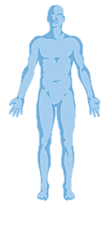
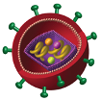
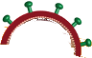

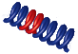
Life Cycle Of HIV
HIV gets into the body of the person
HIV enters into macrophages
RNA genome of the virus replicates to form viral DNA using reverse transcriptase.
Viral DNA gets incorporated into host cell’s DNA using integrase
Infected cells produce virus particles
The macrophages acts like a HIV factory by continuous production of virus
Simultaneously, HIV enters into helper T-lymphocytes (T_{h}), replicates and produce progeny viruses.
The progeny viruses released in the blood attack other helper T-lymphocytes.
This is repeated leading to a progressive decrease in the number of helper T-lymphocytes in the body of the infected person.

Slide 63
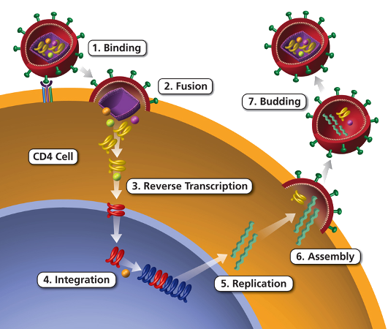
Life Cycle Of HIV

Slide 64
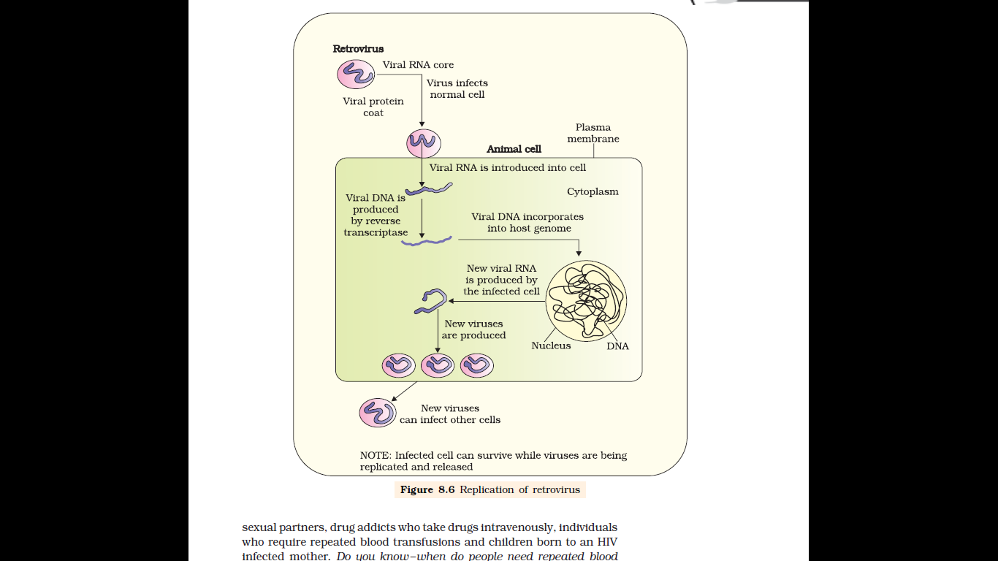

Slide 65
HIV-AIDS
During the period of progressive decrease in the number of helper T-lymphocytes in the body, the patient
becomes so immuno-deficient that he/she suffers from various infections.
starts suffering from infections of Mycobacterium (bacteria), viruses, fungi and even parasites like Toxoplasma.
suffers from bouts* of fever, diarrhoea and weight loss.
*Period of illness

Slide 66
Diagnosis and treatment of AIDS
A widely used diagnostic test for AIDS is Enzyme Linked Immuno-sorbent Assay (ELISA).
Polymerase chain reaction (PCR) and Western blotting techniques are also used for diagnosis of HIV-AIDS
Treatment of AIDS with anti-retroviral drugs is only partially effective.
Anti-retroviral drugs can only prolong the life of the patient but cannot prevent death, which is inevitable.

Slide 67
Measures/steps taken up to prevent HIV infection by WHO, NACO and NGOs;
Making blood (from blood banks) safe from HIV,
ensuring the use of only disposable needles and syringes in public and private hospitals and clinics,
free distribution of condoms,
controlling drug abuse,
advocating safe sex and
promoting regular check-ups for HIV in susceptible populations, are some such steps taken up.
Notes:
Infection with HIV or having AIDS is something that should not be hidden – since then, the infection may spread to many more people.
HIV/AIDS-infected people need help and sympathy instead of being shunned by society.
Unless society recognises it as a problem to be dealt with in a collective manner – the chances of wider spread of the disease increase manifold.
It is a malady that can only be tackled, by the society and medical fraternity acting together, to prevent the spread of the disease.

Slide 68
CANCER
Cancer is one of the most dreaded diseases of human beings.
It is a major cause of death all over the globe.
Some of the research area in cancer biology and medicine are;
oncogenic transformation of cells (mechanisms underlying development of cancer),
Treatment of cancer and
Control of cancer.

Slide 69
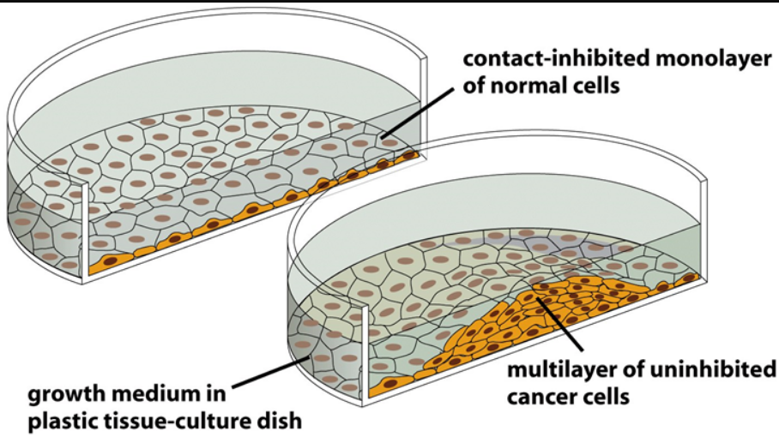
CANCER
Normal Cell | Cancer Cell
Cell growth and differentiation is highly controlled and regulated
Cancer cells undergo uncontrolled and unregulated growth and differentiation
Show a property called contact inhibition* by virtue of which contact with other cells inhibits their uncontrolled growth.
Cancer cells have lost property of contact inhibition. As a result of this, cancerous cells continue to divide giving rise to masses of cells called tumors.
*Contact inhibition is a regulatory mechanism that functions to keep cells growing into a layer one cell thick (a monolayer). If a cell has plenty of available substrate space, it replicates rapidly and moves freely.

Slide 70
CANCER
Tumors are of two types:
benign and
malignant.
Benign tumors normally remain confined to their original location and don’t spread to other parts of the body and cause little damage.
The malignant tumors are a mass of proliferating cells called neoplastic or tumor cells.
Neoplastic cells grow very rapidly, invade and damage the surrounding normal tissues i.e. neoplastic cells starve the normal cells by competing for vital nutrients.
Neoplastic cells sloughed from malignant tumors reach distant sites through blood, and wherever they get lodged in the body, they start a new tumor there. This property called metastasis
Metatasis is the most feared property of malignant tumors.

Slide 71
CANCER
Normal cells loose property of contact inhibition
Abnormal, uncontrolled, unregulated growth and differentiation of cancer cells
Benign tumors (with neoplastic cells)
Metastasis
Malignant tumor
*Abnormal and uncontrolled growth of tissue

Slide 72
Carcinogens causing cancer
(Various causes of transformation of normal cells into cancerous neoplastic cells)
Chemical agents
or
chemical carcinogens
(tobacco smoke is a major cause of lung cancer)
Biological agents
Physical agents
(cause DNA damage leading to neoplastic transformation)
Ionising radiations
(X-rays and gamma rays)
Non-ionizing radiations (Ultraviolet Radiation –UV)
Oncogenic viruses (Cancer causing viruses) have viral oncogenes
Cellular oncogenes (c-onc) or proto oncogenes in normal cells which on activation under certain conditions, could lead to oncogenic transformation of the cells.

Slide 73
Diagnosis of Cancer
Blood and bone marrow tests
Biopsy and histopathological studies
Imaging techniques: Radiography (use of X-rays), CT (computed tomography) and MRI (magnetic resonance imaging - uses strong magnetic fields and non-ionising radiations )
Immunological techniques
Techniques of molecular biology

Slide 74
Cancer detection and diagnosis
Early detection of cancers is essential as it allows the disease to be treated successfully in many cases.
Cancer detection is based on biopsy and histopathological studies of the tissue and blood and bone marrow tests for increased cell counts in the case of leukemias.
In biopsy, a piece of the suspected tissue cut into thin sections is stained and examined under microscope (histopathological studies) by a pathologist.
Imaging techniques like radiography and CT (computed tomography) use of X-ray to generate a three-dimensional image of the internals of an object.
MRI (magnetic resonance imaging) uses strong magnetic fields and non-ionising radiations to detect cancers of the internal organs.
MRI and CT detect pathological and physiological changes in the living tissue accurately .

Slide 75
Cancer detection and diagnosis
Antibodies against cancer-specific antigens are also used for detection of certain cancers.
Techniques of molecular biology can be applied to detect genes in individuals with inherited susceptibility to certain cancers.
Identification of such genes, which predispose an individual to certain cancers, may be very helpful in prevention of cancers.
Such individuals may be advised to avoid exposure to particular carcinogens to which they are susceptible (e.g., tobacco smoke in case of lung cancer).

Slide 76
Common approaches for treatment of cancer
Surgery,
Chemotherapy
Radiation therapy and
Immunotherapy

Slide 77
Treatment of cancer
The common approaches for treatment of cancer are
surgery,
radiation therapy and
immunotherapy.

Slide 78
Treatment of cancer
In radiotherapy, tumor cells are irradiated lethally, taking proper care of the normal tissues surrounding the tumor mass.
Several chemotherapeutic drugs are used to kill cancerous cells.
Some of these are specific for particular tumors.
Majority of drugs have side effects like hair loss, anemia, etc.
Most cancers are treated by combination of surgery, radiotherapy and chemotherapy.
Tumor cells have been shown to avoid detection and destruction by immune system. Therefore, the patients are given substances called biological response modifiers such as an interferon which activate their immune system and help in destroying the tumor.

Slide 79
Drugs And Alcohol
Questions and Answer

Slide 80
Questions On Drugs And Alcohol
Explain drug abuse [ab (=Abnormal) +use]
Answer: When drugs are taken for purposes other than medicinal or taken in amounts or frequencies that impairs physical, physiological or psychological functions, it is called drug abuse.
Explain alcohol abuse
Answer: When alcohol is consumed for purposes other than medicinal or taken in amounts or frequencies that impairs physical, physiological or psychological functions, it is called alcohol abuse

Slide 81
Questions On Drugs And Alcohol
Enlist different categories of drugs.
Answer: Drugs belong to different categories which are as follows;
Opioids
Cannabinoids
Coca alkaloid and cocaine
Hallucinogens
Tobacco

Slide 82
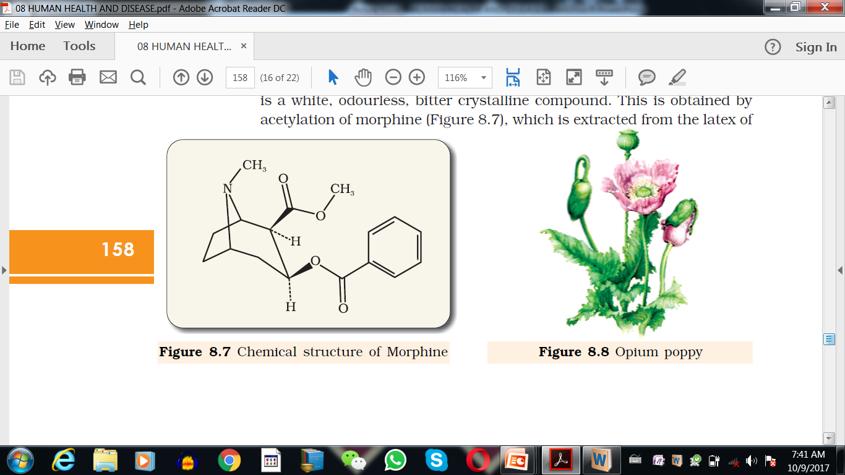
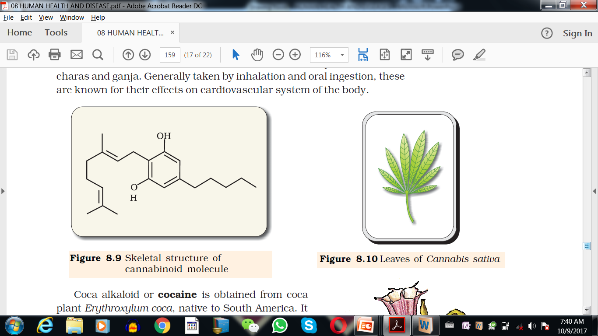
Chemical structure of drugs that you should identify

Slide 83
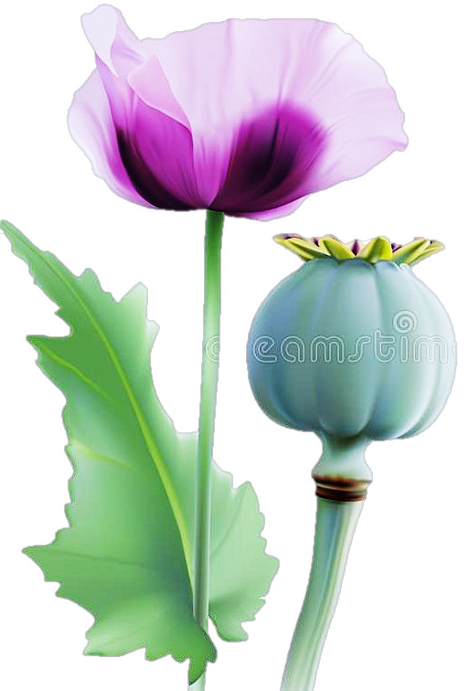
Opioids
Morphine is extracted from the latex^{(white fluid)} of poppy plant (Papaver somniferum).
Heroin/smack (obtained by acetylation of morphine) is a white, odourless, bitter, crystalline compound.
Source
Mode of intake
Mode of action/Organ system affected
Effects
By snorting(blowing of air with drugs into nostrils) and injection.
They bind to specific opioid receptors in the Central Nervous System (CNS) and gastrointestinal tract.
Heroin is a depressant and slows down body functions.
Morphine is an effective sedative (calming effect) and painkiller
Papaver somniferum

Slide 84
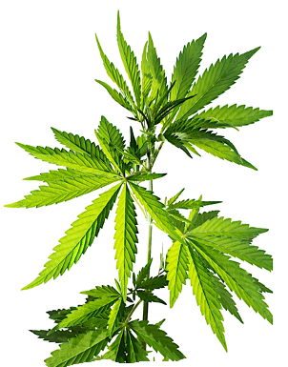
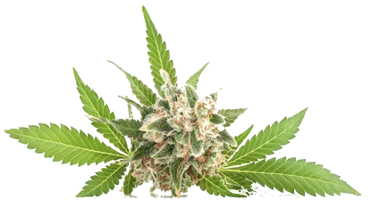
Cannabinoids
Source
Mode of intake
Mode of action/Organ system affected
Effects
Obtained from inflorescence of the plant Cannabis sativa.
Flower tops, leaves and resins of C. sativa in various combinations produce hashish, charas, marijuana and ganja.
By inhalation and oral ingestion.
Cannabinoids interact with cannabinoid receptors present in the brain.
Effect the cardiovascular system of the body.
Cannabis sativa

Slide 85


Coca alkaloid and cocaine*
Source
Mode of intake
Mode of action/Organ system affected
Effects
Derived from the leaves and young branches of Erythroxylum coca -South American plant
Sniffing^{(drawing into nostrils)} and snorting
It has a potent stimulating action on central nervous system and interferes with the transport of the neurotransmitter dopamine.
It is a strong stimulant and when taken in overdose causes headache, convulsions^{(irregular movements of body)}, hallucinations and death due to cardiovascular or respiratory failure.
*Cocaine is commonly called as coke or crack
Erythroxylum coca

Slide 86


Hallucinogens (Psychedelic drugs)
Source
Mode of intake
Mode of action/Organ system affected
Effects
Obtained from plants like Atropa belladona and Datura sps. Lysergic acid diethyl amide (LSD) is derived from the fungus Claviceps purperea.
Taken orally (ingested)
These drugs are called psychedelic drugs because of their effect on cerebrum and sense organs.
These drugs effect thoughts, feelings and perceptions of an individual.
Medically these are given to patients to cope with mental illnesses like depression and insomnia.
Atropa belladona
Datura sps.

Slide 87
Uses and abuse of drugs
Drugs like barbiturates, amphetamines, benzodiazepines, and lysergic acid diethyl amides (LSD) normally used as medicines to help patients cope with mental illnesses like depression and insomnia.
Morphine is a very effective sedative and painkiller, and is very useful in patients who have undergone surgery.
Several plants, fruits and seeds having hallucinogenic properties have been used for hundreds of years in folk-medicine, religious ceremonies and rituals all over the globe.
Cannabinoids are abused by some sportspersons.

Slide 88
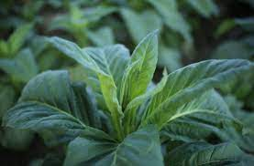
Tobacco
Source
Mode of intake
Main component of tobacco
Effects, Mode of action/Organ system affected
Tobacco plant
It is smoked, chewed or used as a snuff.
It has nicotine -an alkaloid
Nicotine stimulates adrenal gland to release adrenaline and nor-adrenaline into blood circulation, both of which raise blood pressure and increase heart rate.
It increases the chances of lung cancer, bronchitis, emphysema, coronary heart diseases, cancer of throat, gastric ulcer, cancer of urinary bladder, etc.
Smoking leads to increase in carbon monoxide content of blood and reduces concentration of haem-bound oxygen, as a result of which oxygen deficiency in the body is created.
Chewing of tobacco causes oral cancer which becomes fatal in extreme conditions.

Slide 89
Alcohol
Source
Mode of intake
Mode of action/Organ system affected
Effects
Oral intake
Alcohol has an anaesthetic effect on nervous system affecting cerebrum, cerebellum and other parts.
It may cause euphoria, peptic ulcer, gastric carcinoma, hepatitis, liver failure, and liver cell carcinoma.

Slide 90
Questions On Drugs And Alcohol
Define addiction
Answer: The psychological attachment to certain effects such as euphoria [A feeling of great elation (usually exaggerated)] and temporary feeling of well-being, associated with drugs and alcohol is called addiction.
What are the reasons for alcohol abuse in adolescents?
Answer:
Social pressure.
Curiosity and need for adventure, excitement and experiment.
To escape from stress, depression and frustration.
To overcome hardships of daily life.
Unstable or unsupportive family structure.

Slide 91
Questions On Drugs And Alcohol
Define dependence
Answer: The tendency of the body to manifest characteristic and unpleasant withdrawal syndrome on abrupt discontinuation of regular dose of drugs/alcohol is called dependence.
What are the Characteristics of withdrawal symptoms?
Answer:
Anxiety
Shakiness
Nausea
Sweating
Vomiting
Diarrhoea
Insomnia
Muscular and abdominal cramps
Restlessness

Slide 92
Questions On Effects of Drug and Alcohol Abuse
Which organ system is affected by alcohol?
Answer: Alcohol has an anaesthetic effect on nervous system, affecting cerebrum followed by cerebellum and other parts. Also damage liver.
What are the side effects of drugs on females and males?
Answer:
Side effects of drugs on
Females | Males
Masculinisation, Aggressiveness, Mood swings, Depression, Abnormal menstrual cycles, Enlargement of clitoris and Excessive facial and body hair. | Appearance of acne, Aggressiveness, Reduction in size of testicles, Decreased sperm production, Premature baldness, Enlargement of prostate gland.

Slide 93
Questions On Effects of Drug and Alcohol Abuse
What are the warning signs of drug and alcohol abuse?
Answer: Warning signs of drug and alcohol abuse are;
Drop in academic performance.
Absence from school/college.
Lack of interest in personal hygiene.
Isolation, depression, fatigue, aggressive and rebellious behaviour
Deteriorating relationships with family and friends,
Fluctuation in weight, etc.

Slide 94
Questions On Effects of Drug and Alcohol Abuse
What are the ill effects of drugs and alcohol?
Answer: The ill effects of drugs and alcohol can be;
Those who take drugs intravenously develop a risk of AIDS and hepatitis-B.
Use of alcohol during adolescence may lead to heavy drinking in adulthood.
The chronic use of drug and alcohol damages nervous system and liver (cirrhosis) and the alcoholism during pregnancy affects the foetus.
Enumerate the prevention and Control?
Answer: Prevention and Control measures are;
Avoid undue peer pressure.
Educating and counselling the problems and stresses to avoid disappointments and failures in life
Seeking help from parents and peers.
Looking for danger signs to take appropriate measures on time
Seeking for professional and medical help whenever required.

Slide 95
Chapter ends here.....

Slide 96
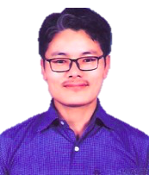
Teacher
Mr. Lhakpa Wangyal
PGT Biology
Email: lhakpawangyal@gmail.com
Contact number: 84497 99894
Social Baluni Public School

Slide 97
Life Cycle Of HIV
HIV gets into the body of the person
HIV enters into macrophages
RNA genome of the virus replicates to form viral DNA using reverse transcriptase.
Viral DNA gets incorporated into host cell’s DNA
Infected cells produce virus particles
The macrophages acts like a HIV factory by continuous production of virus
Simultaneously, HIV enters into helper T-lymphocytes (T_{h}), replicates and produce progeny viruses.
The progeny viruses released in the blood attack other helper T-lymphocytes.
This is repeated leading to a progressive decrease in the number of helper T-lymphocytes in the body of the infected person.

